Slide 1
Demystifying Introductions and Conclusions

Slide 2
Students will be able to…
analyze the comparisons between google maps and introductions / conclusions
01
identify the techniques used in an introduction or a conclusion
02
analyze introductions and conclusions for their value
03
write successful introductions and conclusions
04

Slide 3
Essential Competencies
Assessment
Compose expository essays
LifeMap
Mutable structures
Info literacy
Inclusion and Diversity
Diverse perspectives
Discussions of map-making
Learning-Centered Teaching Practices
Critical reading
Notes:
THIS SLIDE FOR INSTRUCTORS:
Within this module, you will find content and assessments that align with several different Valencia Essential Competencies.
ASSESSMENT: This module includes formative opportunities for online and f2f students to test their knowledge using the features of Google Maps. Slides encourage students to participate and self-check their knowledge against “answer” slides to ensure competency
LIFEMAP: The skills within this module are designed to prepare students to write introductions and conclusions in any written genre and for any audience. The skills herein provide opportunities for students to understand and assess the needs of a genre and audience prior to composing the writing. INCLUSION AND DIVERSITY: The use of real-world maps provides opportunities for discussions about how and why we navigate the way we do, and how maps are created or used in different communities.
LEARNING-CENTERED TEACHING PRACTICES: This module is designed to impress upon students the skills of critical thinking and critical reading to ascertain the needs of an audience and genre, instead of following the formulaic conventions of introductions in high school writing.

Slide 4
On the next slide, you’re going to see the Google Maps landing screen. Point out as many features of the map as you can…

Slide 5
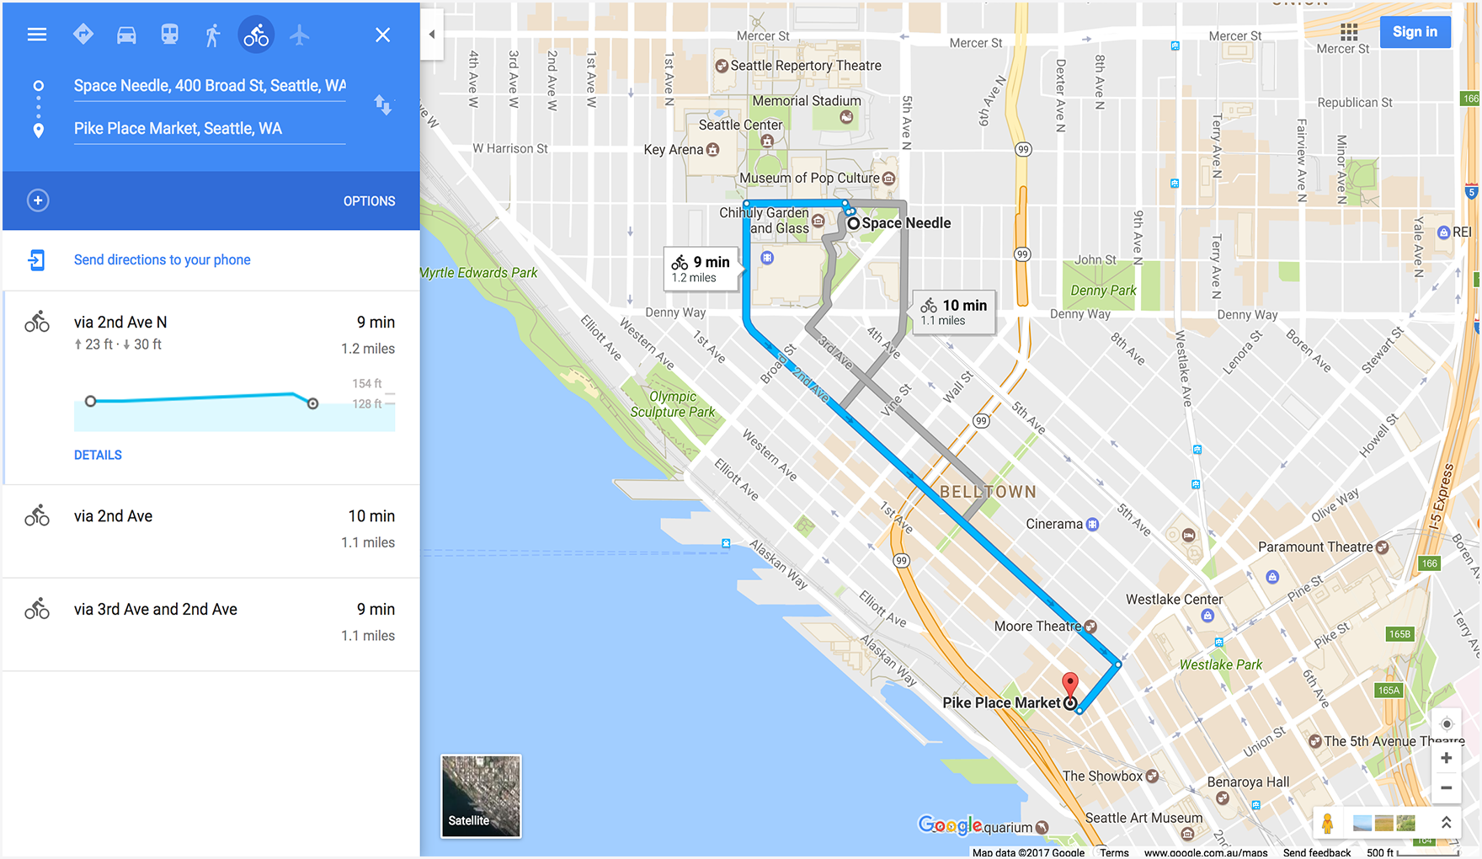

Slide 6
What’s on your list?
Starting point
Destination
Different routes available
Types of transportation
The surrounding area on the map
Major landmarks
Distance and time to travel
Turn by turn instructions

Slide 8
What our directions provide
JUST enough context to understand our journey
The specific starting knowledge
Think of the reader
The specific location of the end
Spoil the end!
Only the necessary overview
But relevant contextual information along the way
Traffic, tolls, detours, alternate routes, locations along the way
How broad or narrow

Slide 9
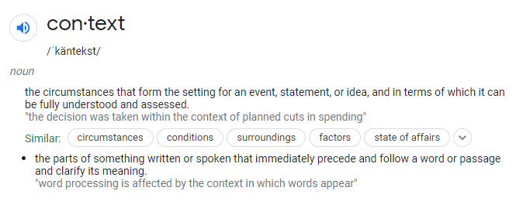
What is context?
Where is your claim coming from?
What perspective are you using?
Make clear beliefs/premises that inform your ideas

Slide 10
Each of these are map parts are similar to components of the introduction of an essay

Slide 11
What’s on your list?
(Starting Point) Reader’s current knowledge of the topic
(Destination) What you want to prove
(Different Routes) Different ways to reach an audience
(Transportation) Different modes of essays / genres
(Surrounding Area) Context for the argument in our world
(Landmarks) Major ideas and themes
(Distance/Time) How in depth or long your essay will be
(Turn directions) A step by step guide of the points you’ll cover

Slide 12
Your essay is a journey across a map
INTRODUCTIONS: invitations from the speaker, to the reader, to join you in discovery
They should appeal to the reader’s needs for tone, background, and knowledge
They should place the problem in context and suggest something about organization
Doesn’t need to be one paragraph; thesis doesn’t need to be the last sentence, OR have three parts.

Slide 13
Conclusions focus on the connection between the world of the essay and the world we live in
CONCLUSIONS
This DOES NOT, EVER, NEVER, summarize the paper
We just read it
Like… why would we need that
Instead, develop your final, most significant point
Look to the future!
Implications and applications of your ideas

Slide 14
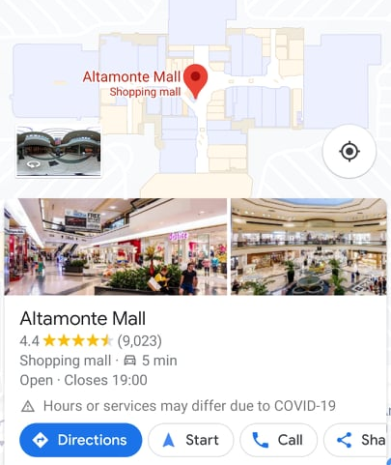
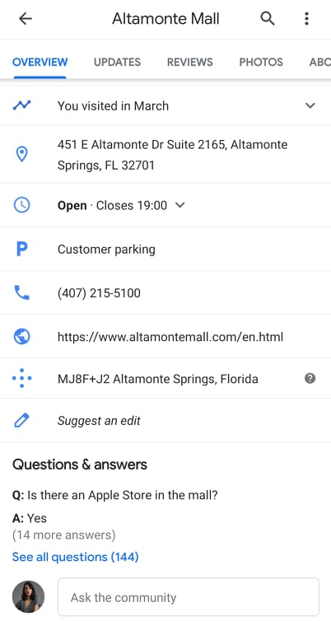
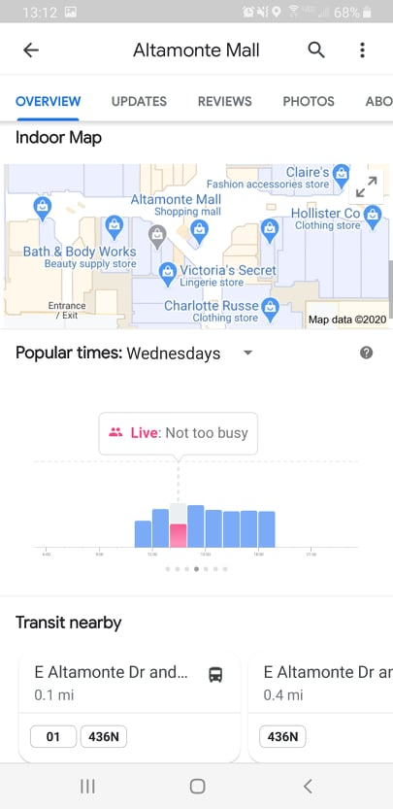

Slide 15
We can learn conclusions from maps as well
Information pertinent to the reader’s interests and values
Answering outstanding questions
A closer look at the place we’ve arrived
Popularity or social reception of the proven claim
When this information matters
How to use the information moving forward
Related topics and themes to the proven claim
What to do next, a call to action

Slide 16
Remember
There’s no second chance to make a first impression on a reader

Slide 17
How to use this in the classroom
Conceptual essay mapping
Literal essay mapping
Map as process essay

